Slide 1

SWENG 861 Final Project
Sowmya talasila

Slide 2

Project
A webapp that lets user find out information about songs and artists
Hosted on a web interface
Language Used: Python, HTML, CSS, JavaScript
Flask
Spotify API for Developers

Slide 3
ARCHITECTURE DIAGRAM
Client (Web Browser
Flask (Handles HTTP Requests and controls routes)
Spotify (Makes an API call and gets information from Spotify

Slide 4
CHALLENGES/OPPORTUNITIES
Opportunities:
01
Chance to learn about using REST APIs
Connecting frontend and backend
Challenges:
02
Figuring out which API to use
Never done this before

Slide 5
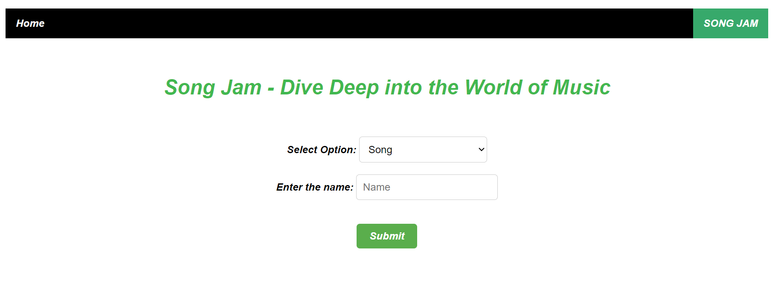
DEMO
Link to Demo

Slide 6

CONCLUSION
Good Experience
Learned how to connect backend and frontend using Flask
Also learned about how to use REST APIs

